Slide 1
Snyk & SentinelOne
Technical Integration and Partnership

Slide 2
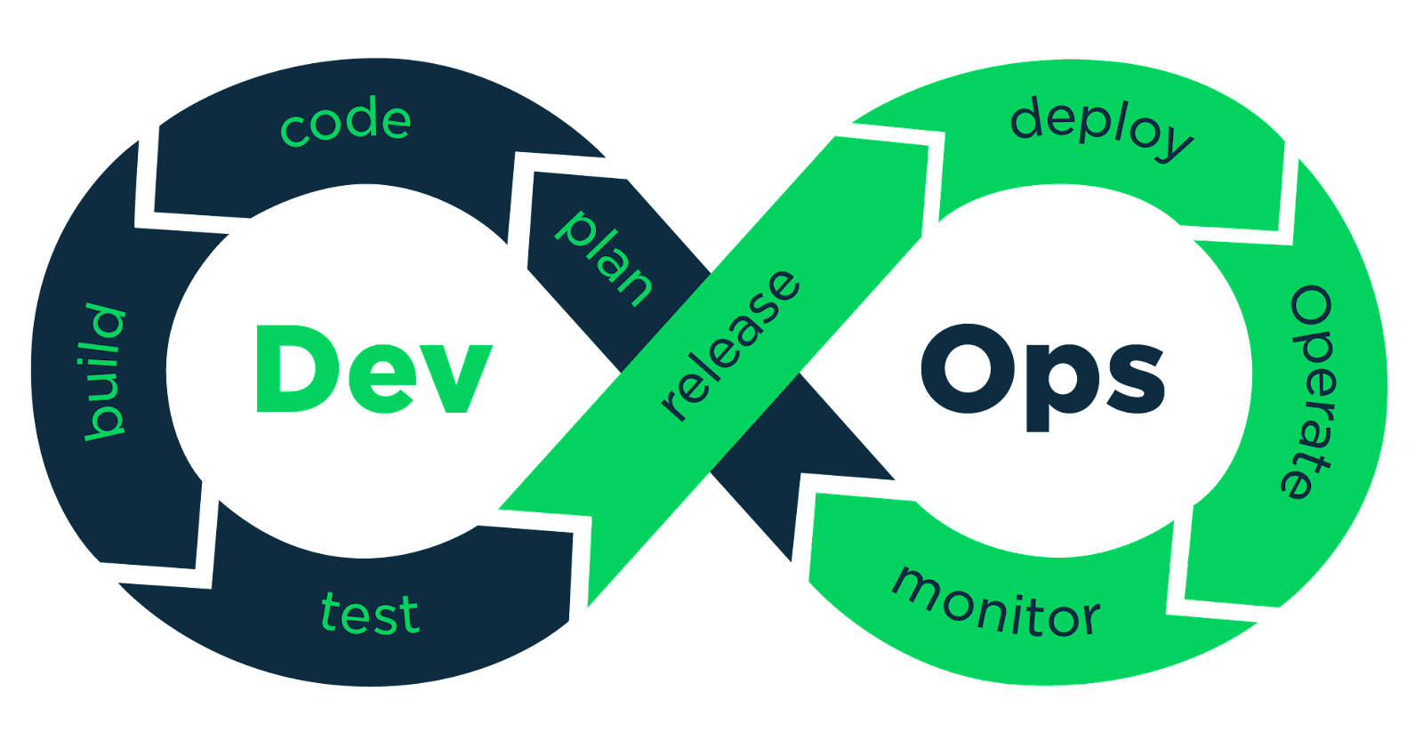
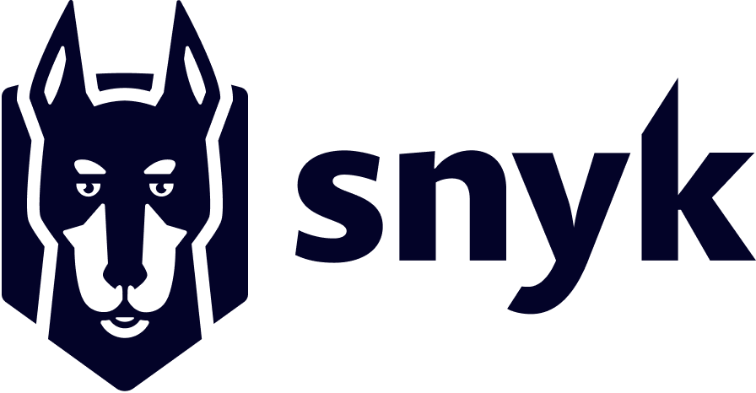
Security from Code to Cloud
Frictionless collaboration between Developers, AppSec and SecOps
#WeAreExclusive
Find and fix vulns in your source code
Real-time CWPP

Slide 3
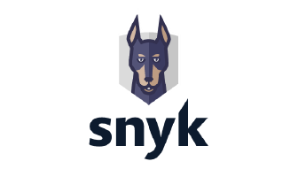
AppSec
Software vulns, image scanning, “shift left”
CWPP
Runtime threat detection, response
CSPM
Config management, IaC templates, drift management, etc.
#WeAreExclusive
CIEM
Identity and entitlements for human and machine roles
DSPM
Data security, malware scans of object storage, etc.

Slide 4
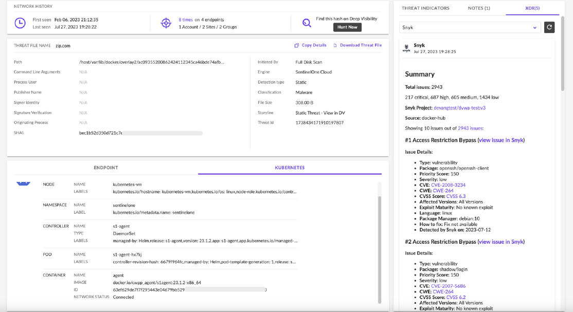
SentinelOne Console
Runtime Threat Detected by SentinelOne CWPP
Vulns identified by Snyk in workload source code
#WeAreExclusive

Slide 5
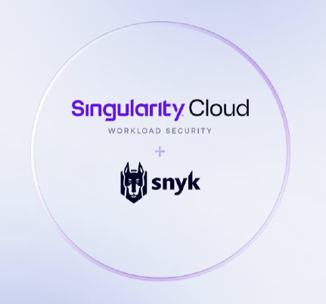
Customer Benefits
Improve Visibility
Automatically correlate build time vulnerabilities to runtime threats, shown in the same console. Understand root cause quickly.
Better Prioritization & Response
Automate response actions by policies you control to stop the spread. Prioritize vulnerabilities impacting production and solve them at the source.
#WeAreExclusive
Better Cloud Security Outcomes
Continuous feedback loop leads to more secure cloud operations. Drive more complete understanding quickly, to slash incident response time and improve risk management.
LEARN MORE:
www.sentinelone.com/partners/snyk
Step by Step Walk-Thru

Slide 6
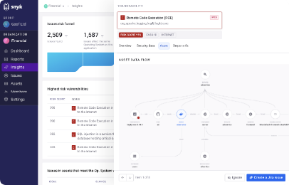
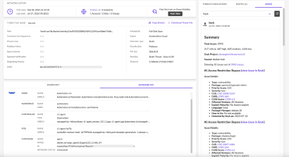
Snyk & SentinelOne Integration
• Bi-directional integration, in 2 phases, for build time to runtime security
• Deep links to switch between Snyk and SentinelOne consoles
Build Time
PHASE: 1
Runtime
Container image vulnerabilities from Snyk pulled into S1 (Nov 2023)
#WeAreExclusive
Runtime threats from S1 pushed to Snyk (H1 2024)
Correlate and contextualize vulnerable container images with runtime threats
Prioritise and fix build time vulnerabilities and reduce alert fatigue
PHASE: 2
Runtime threat enrichment with build-time vulnerability context for improved RCA
Threat hunting & investigations

Slide 7
DEMO

Slide 8
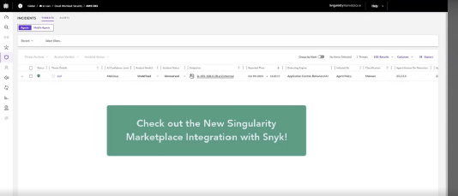
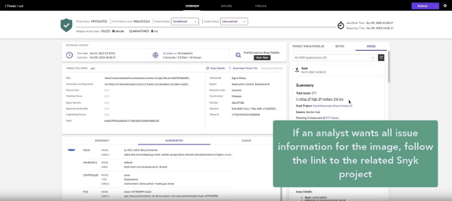
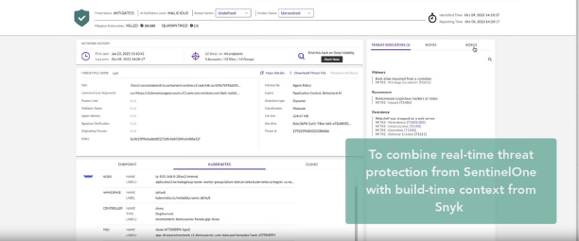
Snyk & SentinelOne Integration
#WeAreExclusive

Slide 9
Thank You
sentinelone.com/partners/snyk

